Slide 1
Talend Integration Studio
Introduction

Slide 2
Day 1 Agenda
Introduction
Talend Environment
Talend Jobs Designing
Working with files and databases
Transformations & Orchestration Components

Slide 3
Introduction
Talend was founded in 2005 by Bertrand Diard and Fabrice Bonan. It was the first commercial open source vendor of data integration software.
Talend is an open source software vendor that provides
Data integration
Data management
Enterprise application integration
Big data software and services.
Headquartered in Redwood city, California, Talend has offices in North America, Europe and Asia, and an international network of technical and service partners.
It has 400 employees in 14 offices in 7 countries

Slide 4
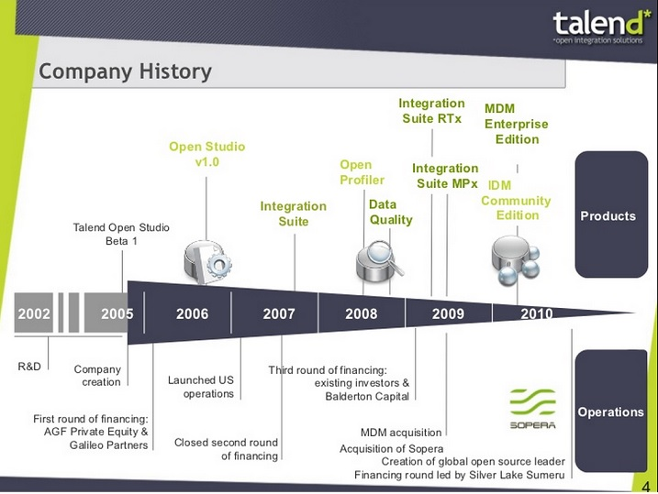

Slide 5
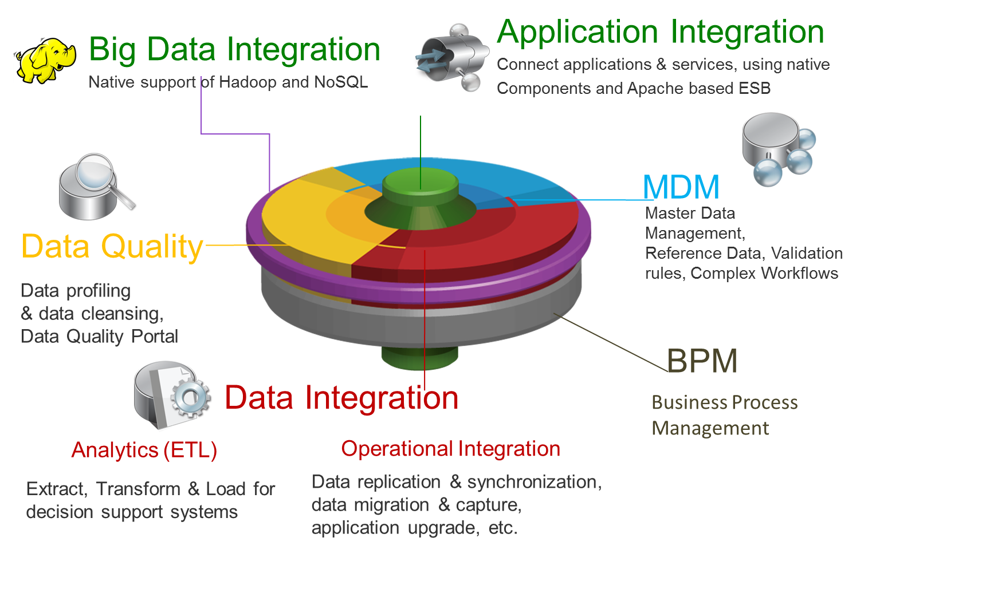
Products

Slide 6
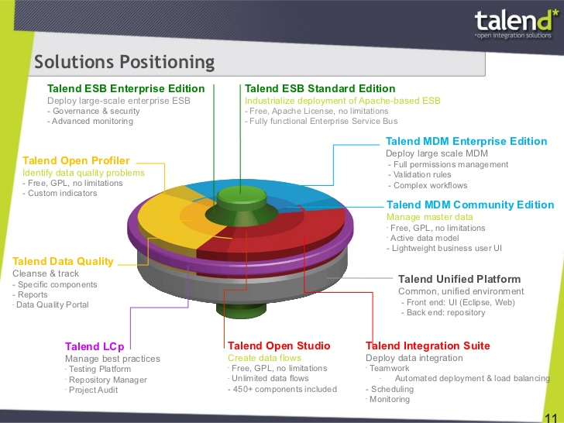

Slide 7
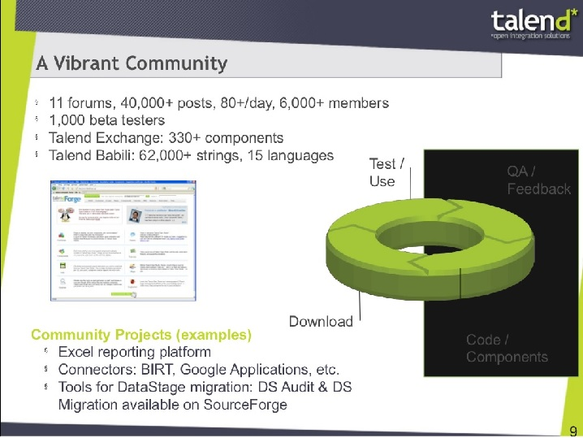

Slide 8
Introduction to Talend Products

Slide 9
Talend Data Fabric
Eclipse based visual programming IDE for ETL application
Java code generator By choosing java, we have all the advantages and disadvantages of this language
600+ connectors for open and proprietary data systems
Unified user interface across all components. Based on Eclipse, the knowledge of the tool enables us to use the interface
Central metadata repository
Available in both open source and Enterprise editions

Slide 10
Talend Data Preparation
Eclipse based visual programming IDE for ETL application
Java code generator By choosing java, we have all the advantages and disadvantages of this language
600+ connectors for open and proprietary data systems
Unified user interface across all components. Based on Eclipse, the knowledge of the tool enables us to use the interface
Central metadata repository
Available in both open source and Enterprise editions

Slide 11
Talend Cloud Integration
Eclipse based visual programming IDE for ETL application
Java code generator By choosing java, we have all the advantages and disadvantages of this language
600+ connectors for open and proprietary data systems
Unified user interface across all components. Based on Eclipse, the knowledge of the tool enables us to use the interface
Central metadata repository
Available in both open source and Enterprise editions

Slide 12
Talend Data Quality
Eclipse based visual programming IDE for ETL application
Java code generator By choosing java, we have all the advantages and disadvantages of this language
600+ connectors for open and proprietary data systems
Unified user interface across all components. Based on Eclipse, the knowledge of the tool enables us to use the interface
Central metadata repository
Available in both open source and Enterprise editions

Slide 13
Talend Master Data Management
Eclipse based visual programming IDE for ETL application
Java code generator By choosing java, we have all the advantages and disadvantages of this language
600+ connectors for open and proprietary data systems
Unified user interface across all components. Based on Eclipse, the knowledge of the tool enables us to use the interface
Central metadata repository
Available in both open source and Enterprise editions

Slide 14
Talend Metadata Manager
Eclipse based visual programming IDE for ETL application
Java code generator By choosing java, we have all the advantages and disadvantages of this language
600+ connectors for open and proprietary data systems
Unified user interface across all components. Based on Eclipse, the knowledge of the tool enables us to use the interface
Central metadata repository
Available in both open source and Enterprise editions

Slide 15
Features
Eclipse based visual programming IDE for ETL application
Java code generator By choosing java, we have all the advantages and disadvantages of this language
600+ connectors for open and proprietary data systems
Unified user interface across all components. Based on Eclipse, the knowledge of the tool enables us to use the interface
Central metadata repository
Available in both open source and Enterprise editions

Slide 16
Installation requirements
Memory usage heavily depends on the size and nature of your Talend projects. However, in summary, if your Jobs include many transformation components, you should consider upgrading the total amount of memory allocated to your servers, based on the following recommendations
Environment variable configuration
Prior to installing your Talend solutions, you have to set the JAVA_HOME Environment variable
Define your JAVA_HOME environment variable so that it points to the JDK directory
For example, if the JDK path is C:\Java\JDKx.x.x\bin, you must set the JAVA_HOME environment variable to point to: C:\Java\JDKx.x.x.
Product | Client / Server | Memory | Disk space installation + use
Studio | Client | 3 GB min, 4 GB recommended | 6+ GB

Slide 17
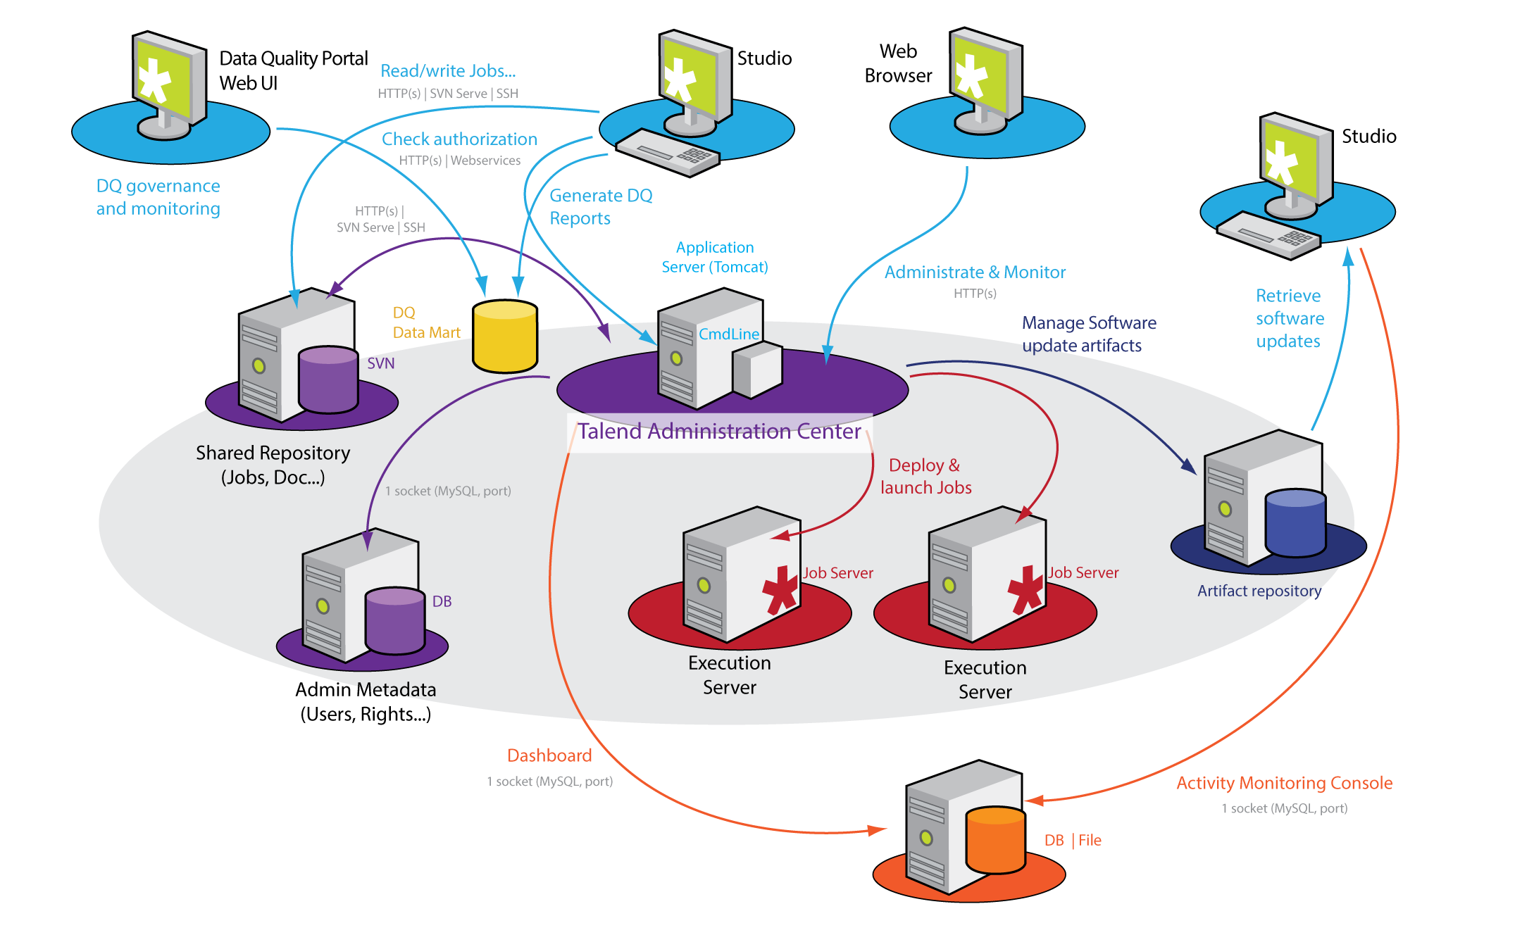
Talend Product Architecture

Slide 18
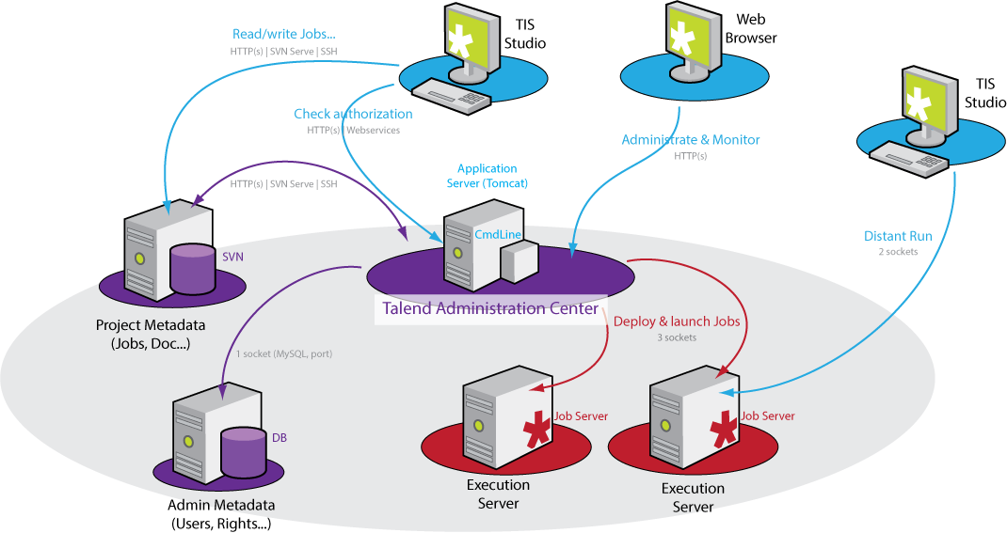
TIS Functional Architecture

Slide 19
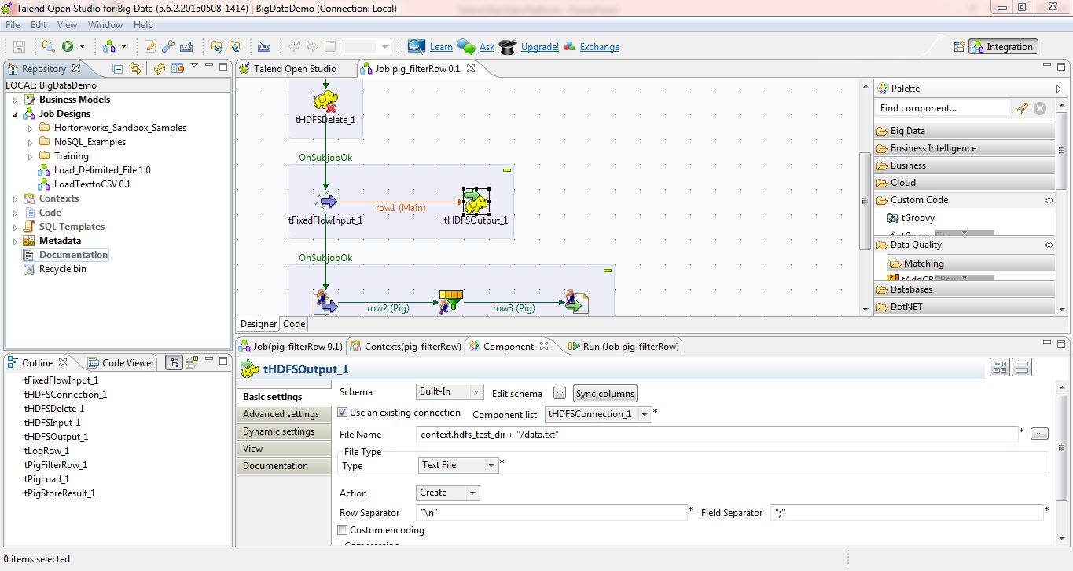
TIS Interface

Slide 20
TIS – Important Terminologies

Slide 21
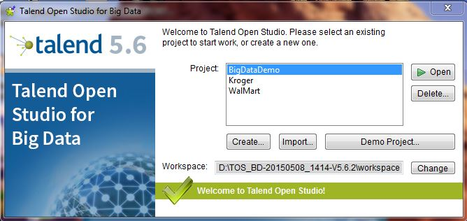
Workspace
Workspace – is a container of Projects which shares the same TIS version and the same components palette.
Similar to Eclipse, you can choose which one to use when the program starts.
In case of community version, it’s a folder in the local drive

Slide 22
Projects
Project is a set of jobs and involved metadata
Its defined under a subfolder into the Workspace
Different projects in the same workspace can have different settings
Internally, it’s a mix of XML, .item & .properties files in a classical Eclipse flavour

Slide 23
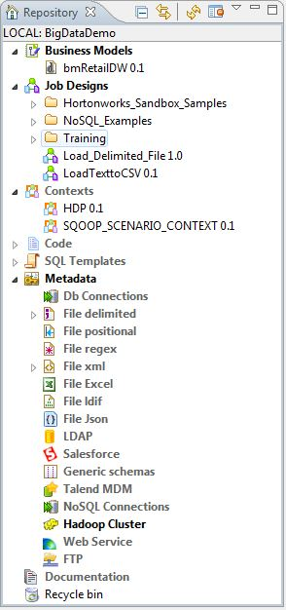
Metadata
TIS requires preliminary definition and description of jobs using metadata. The repository holds this information
There are total 8 types of metadata. We’ll look the most important ones in detail
Business Model
Job Design
Contexts
Code
SQL Template
Metadata
Documentation
Recycle bin

Slide 24
Metadata – Business Model
It stores diagram used to conveniently describe business models and embed them with ETL
It offers a small set of drawing capabilities in UML-fashion
Not widely used, but proven to be useful to quickly sketch-up transformation goals and for auto-documenting ETL design

Slide 25
Metadata – Job Designs
Heart of the TIS repository, the jobs themselves
It stores all the metadata required for graphically describing the jobs
Components used
Connectors
Signals
Parameters
Etc.
You can(rather you should!!!) organize them in a tree manner for better clarity

Slide 26
Metadata - Contexts
It stores context groups which are parameters sets that can be used by any job in current project
A group is a set of initialized java variables of one of the allowed types in global scope
Note – Groups are for presentation only; there is not limitation on how many or how to use context variables in jobs

Slide 27
Metadata - Code
It stores routines written in Java;
These routines are typically a set of static methods inside a class
Consider using Maven and git while creating a routine for better reliability
https://github.com/theclue/talend-routine-collection

Slide 28
Metadata
It stores a heterogeneous set of reusable, atomic elements for jobs
They include database parameters and credentials, external files schema, web service interface, business applications connections, etc.

Slide 29
Anatomy of Talend Job

Slide 30
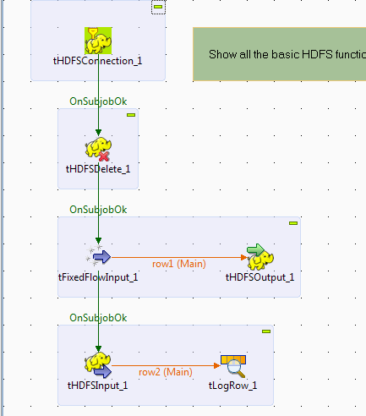
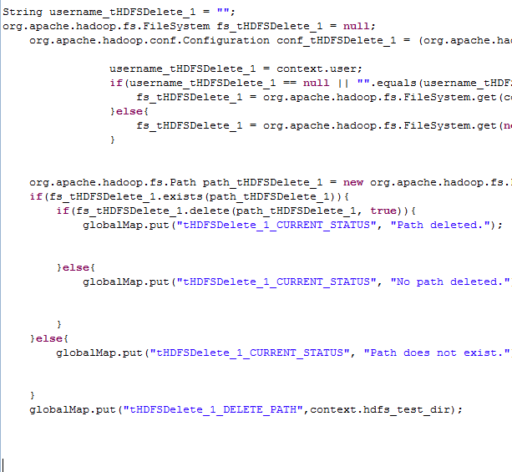
Definition of Job
A Job visual set of components graphically connected using different connections
From visual canvas and the connection topology, TIS in turn generates java code
This code is procedural by design and not really object oriented

Slide 31
Connections
Main
The main connection in a job dictate the data flow
They carry on vectors of data ( one vector per row/tupple)
When the connection is split, the order dictates who’s come first. You may change it in contextual menu
Lookup
Lookup connections, as the name suggests, make data available for fast-lookup
Typically, lookup data vendors are stored in-memory during job processing

Slide 32
Signals and Data Connections…
ROWS
Rows are connections that carry on data, one tuple at a time
Their content is defined by schema
They are used to connect components
Components connected this way are part of same subjob
Examples
Main
Lookup
Filter
Merge

Slide 33
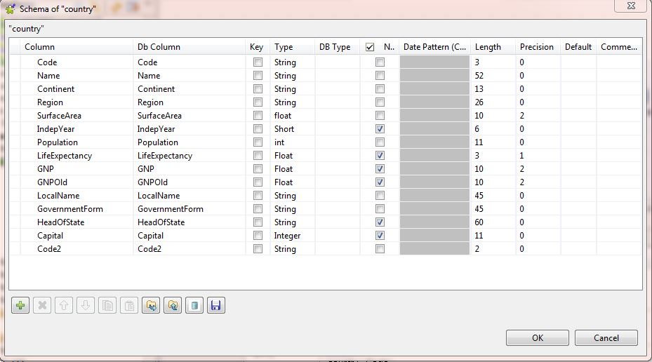
…
SCHEMA
Is an important inner concept of TIS design
Each row connection must have non-null schema declaration which defines the dimensionality of the vector of data ingoing and outgoing to/from a given component
Several primitive java types are supported by TIS

Slide 34
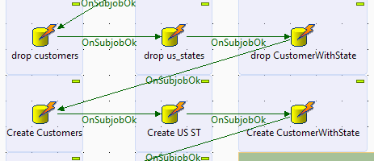
…
TRIGGERS
As name suggest, don’t carry data, but are actually signals. There are two types of it –
Sub Job Triggers
They are used to connect the starting points of subjobs. When connected this way, subjobs will execute sequentially, forcing an execution order.

Slide 35
…
Run If Trigger
Is a special type of trigger that is fired only if the embedded expression is evaluated to true.
The expression must be written in Java and have a Boolean outcome
Iterators
They stand in the middle between Data connections and triggers. They don’t carry on data like rows – they are more like triggers which are fired once for each incoming row.
They originate from standard components like row connections

Slide 36
The Global Map
The Global Map holds parameters defined at runtime. These parameters live in a pure Java space
It’s a key-value map used to store generic objects:
globalMap.put(“Key”, Object) to store an object
globalMap.get(“key”) to get an object
Since it’s an <Object> java map, you must explicitly cast to proper type when getting back the object
Its proven very handy when used in conjuction with Iterators, as they cannot carry data alone

Slide 37
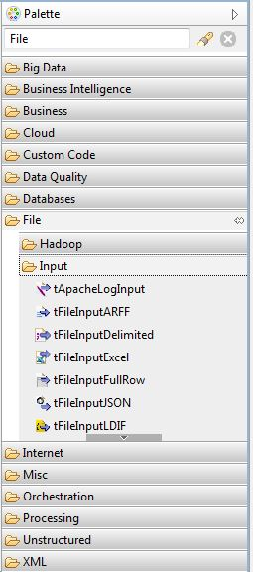
Working with files
Talend offers components to connect with variety of file formats…
These components are used for input and output from / to local files
Under file management – complete set of copy, delete, archive, directory listing is available
1) Apache log | 6) Json
2) Delimited | 7) Multischema delimited
3) Excel | 8) LDIF
4) Full row | 9) Email
5) Positional | 10) Inputproperties

Slide 38
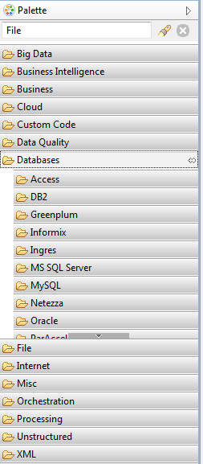
Working with databases
These components are used for performing operations on RDBMS
We’ll now design few jobs to perform operations on MySQL database…
1) AS400 | 8) MS SQL Server
2) Access | 9) MySQL
3) AmazonRDS | 10) MongoDB
4) Cassandra | 11) Netezza
5) DB2 | 12) Oracle
6) Greenplum | 13) PostGreSQL
7) JavaDB | 14) SQLLite

Slide 39
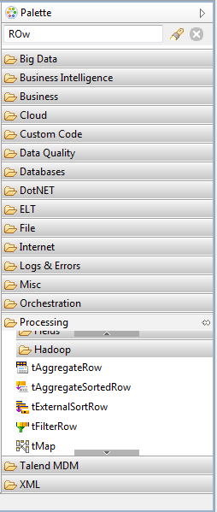
Transformations
These are most important components, following is the list of frequently used components –
Sorting
Aggregation
Filtering (rows / columns)
tMap
Join
Lookup
Normalize / Denormalize
However, tMap is the most commonly used – it’s a general purpose multi input, multi output component

Slide 40
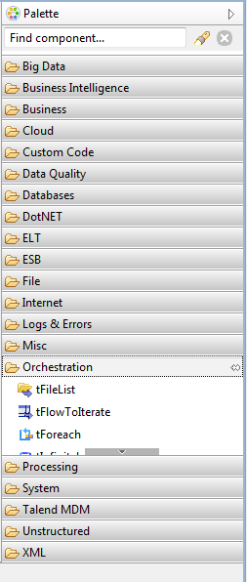
Orchestration Components
These components, as the name states, are used to “make order” inside and outside the jobs
They allow you to call a TIS jobs from another, to put a job in wait state and more
There are also components to switch between row and iterator connections
Mostly used when there is a need to trigger and event for each row in the incoming connection

Slide 41
Component Parameters
When you select a component instance, the parameter pain shows the relevant fields to fill up;
Several types of parameters are allowed: dropdown, radio buttons, schemas, text fields, etc.
Text fields end up writing their value into the generated java code as-is, so be sure to write them correctly:
Enclose strings in double quotes
Be sure to match the expected type, or cast otherwise

Slide 42
Components & Repository
Components allow you to select a relevant metadata from repository
Doing so, you will be able to keep parameters between jobs and component instances “in sync”;
This is not mandatory and at any time you can detach the component from the repository
This brings the component in “built in” state, which means that its parameters are locally defined and won’t be updated anymore if repository is

Slide 43
Assignment-1
Under ..\CITI\Assignments\Day1\Assignment1 folder, there are following files with different formats
Employee.txt (Delimited)
USCityZipCode.txt (Positional)
CountryList.csv
Customer.xls
Step 1
Design metadata for each file
Step 2
Design Talend jobs to convert source files to a delimited file (record delimiter – “^”)
Each job should have three components
Source
tMap
Destination

Slide 44
Assignment-2
Under ..CITI\Assignments\Day1\Assignment2 folder, there are following XML & CSV files
Books.xml
EmployeeSalary.xml
USStateCityZipCode.csv
OrgAddress.csv
Step 1
Design metadata for source and destination files – input & output XML
Step 2
Validate XML files using tXSDValidator component
Step 3
Design Talend jobs to convert XML files to a delimited file (record delimiter – “|”)
Each job should have three components
Source
tMap
Destination

Slide 45
Assignment-2
Step 4
Design Talend jobs to convert CSV files to XML files. Each job should have three components
Source
tMap
Destination

Slide 46
Assignment-3
Under ..\CITI\Assignments\Day1\Assignment3 folder, there are following files with different formats –
Employee.txt
PurchaseOrder.txt
Apche_Log_Entries.xlsx
Step 1
Design metadata for each file
Step 2
Following context variables should be used in Talend job
Source file names
Database connection
Target table names
Step 3
All jobs should carry following basic transformations on source files

Slide 47
Assignment-3
Step 3
All jobs should carry following basic transformations on source files
Convert dates to mm/DD/yyyy format. Null / Blank dates should be defaulted to 12/31/2100
Default integer / numeric columns to 0 / 0.0 if Null / Blank
Remove Empty rows from source files
Target tables should contain ID as identity column
Each file contain some bad records (records with extra delimiter), such records should be rejected from each source file. A xxxxx_rejected.txt file should generated

Slide 48
Day 2 Agenda
Talend Context Variables
Logs & Error Handling
Best Practices & Sample Jobs
Managing Routines
Design Joblets
Design Business Model

Slide 49
Quick Re-cap of yesterday
Introduction to Talend ecosystem
Talend environment overview
Design Talend job
Working with files and databases
Transformations & Orchestration Components

Slide 50
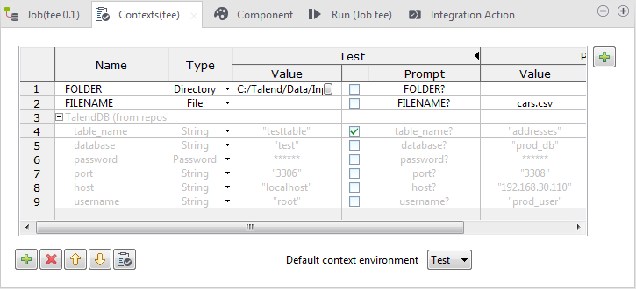
Using contexts & Variables
Variables represent values which change throughout the execution of a program
A global variable is a system variable which can be accessed by any module or function. It retains its value after the function or program using it has completed execution
A context variable is a variable which is defined by the user for a particular context

Slide 51
The context
The context holds the parameters at compile time
These parameters are grouped in Context Groups and defined into the repository as primitive java types
Then, they will end up as public attributes of the context object inside the code
E.g. a parameter named “DBName” will be referenced using syntax context.DBName in code and paramters field.
Just like parameters, “built in” context can be defined, to scope it in local job only

Slide 52
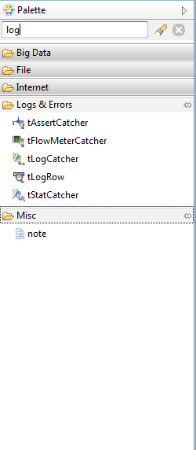
Logs and Error Handling
The Logs & Errors family of components allow you to log information about the execution of your Job
With the exception of tDie, these components play no functional part in the task-specific processing of your Job;
however, they play an important part in the debugging your Jobs and helping to ensure their smooth running

Slide 53
Error Handling Strategies
Talend Open Studio job should die gracefully, notifying the operations team and leaving the data in a good state…
We are going to discuss three strategies
Do Nothing
For simple jobs, say an automated administrative task, you can rely on the exception throwing of Talend Open Studio.
An example is a simple input to output job where a database failure in writing the output results in a system error. This is expressed in the Run View as a red stack trace.

Slide 54
Error Handling Strategies
Talend Open Studio job should die gracefully, notifying the operations team and leaving the data in a good state…
We are going to discuss three strategies
Do Nothing
For simple jobs, say an automated administrative task, you can rely on the exception throwing of Talend Open Studio.
An example is a simple input to output job where a database failure in writing the output results in a system error. This is expressed in the Run View as a red stack trace.

Slide 55
…
Subjob or Component Error Triggers
Each subjob and component has a return code that can drive additional processing.
The Subjob Ok/Error and Component Ok/Error can be used to steer the error toward an error handling routine like the tSendMail component.
Both an individual subjob and a finer-grain component can be tested.
While testing the individual subjobs and components has the advantage of providing error handling tied to the specific case, there are disadvantages in maintenance and testing.
Maintenance suffers because the job becomes cluttered with extra components which can confuse the normal processing, less frequent processing, and the error handling. Testing is harder because there are more test cases.

Slide 56
…
tAssertCatcher
A more general strategy is to define an error handling subjob to be performed when an error -- any error -- occurs. This has the important advantage of consolidating the error handling, dramatically reducing testing. It puts the burden of testing for error conditions on Talend (where it belongs). To implement the general strategy, use the tAssertCatcher component which will be invoked whenever any component throws an error.

Slide 57
Managing Routines
Routines are reusable pieces of Java code. Routines enable you to write custom code in Java to optimize data processing, improve Job capacity, and to extend Talend Studio features.
There are two types of routines in Talend Studio:
System routines: a number of system routines are provided. They are classified according to the type of data they process, such as: numerical, string, date. These types of routines are read-only, and you can call them directly in a Talend Job.
User routines: You can create your own new user routines or adapt existing routines.

Slide 58
Routine Structure
Routine Package
All of your custom routines are placed in a Java package named routines package routines;. You cannot change the package.
Class Comments
Talend adds some class-level comments. These provide you with some helpful information on how to write the comments for your methods.
Class Definition
A new Class has been defined with the name that you entered when you created your routine public class PhoneUtil {.
Method Implementation
A new Public Static Method has been implemented public static void helloExample(String message) {. This is simply created as a helper to get you going.

Slide 59
…
Method Implementation Comments
The method comments that are created by Talend are more than simple comments. These comments control how your new method features in the Talend Designer. You will have seen the structure of these comments documented in the Class comments; but we'll now look at these in a little more depth.
First Comment Lines
The first comment line provides the text that will be shown in the in-line help. This is optional.
{talendTypes}
This value is used to tell the interpreter the Talend return type of the method.

Slide 60
…
{Category}
This value defines the Class' category. This is used within the Talend Designer, to navigate to the method.
{param}
This value defines the parameter types that are passed to the method. Again, this is for use with in the Talend Designer.
{example}
Used to show example usage, within the Talend Designer.
//$NON-NLS-1$
You may see comments similar to this, following String declarations. This is a directive to Eclipse to silence warnings if it encounters string literals (when it has been configured to complain).

Slide 61
Best practices and sample jobs
Good Job design is at the heart of your Talend development. In this section, we’ll look at the different aspects of designing your Jobs
Purpose of Job
Job Architecture
Reusability
Error Handling
Restart & Recovery
Robustness
Logging
Performance (speed of execution)

Slide 62
…
Purpose of Job
The first and possibly easiest of our design goals is What's the purpose of the Job?.
Unfortunately, this is often where it ends. This may be ok for your first simple Job; but this is not a good basis for working on a larger project either on your own or with a team of developers.
Job Architecture
Even the simplest of Jobs needs some design thought. A trivial Job that reads data from a source, performs some manipulation and then writes the results to a target, may only require three basic components.
But what if the Job fails? You may then need to start thinking about recovery and adding some error handling. Suddenly, the Job becomes much more complex than first thought. Often, it’s these aspects of Jobs that gets left for another day.
As Jobs become more complex, it’s important to think about the modularity of your work. What code is common across many Jobs and is reusable? Can a large task be broken down in to several smaller Jobs that can be orchestrated by a master Job?

Slide 63
…
Reusability
A key aspect to our overall design strategy is reusability. Each time we write some reusable and robust code, whether it’s just a simple fragment of code or an entire Job, we are closer to our goal of quickly writing fast and robust Job.
Talend provides many features to help you write reusable code. These include Jobs, Joblets, (Enterprise only), Context Groups, Repository Code Routines, Custom Components and other Repository objects.
Error Handling
As with any programming, your Job may receive errors and these need to be handled. These may be Exceptions thrown by the components in your Job or they may be other softer errors that you also need to handle in some way.
You may, for example, refer to a null Object and receive a NullPointerException. Unless you catch this exception and deal with it, your Job will usually terminate immediately. This may or may not be your desired result.

Slide 64
…
Restart & Recovery
Now that you’re handling errors, you’re in a much better position to deal with your Job should it receive a fatal error.
Can your Job simply be restarted from the beginning? Is that practicable? Or should you restart the Job at a logical point of failure?
Robustness
Once the architecture of your Job is in place, errors are being handled, and there is restart and recovery capability, your Job is well on the way to being reliable and robust.
Logging
it’s good practice to record information about the execution of your Job, over time. This helps with performance tuning and resolving issues.

Slide 65
…
Performance
Performance (usually meaning speed of execution) is often a key metric of a Jobs success or failure. There are many aspects to tuning your Job, including: General Job design, Memory management, I/O, Sharing the load with inputs and outputs (e.g. Databases) and Parallelism.
There are also factors that may not be under the direct control of the Talend Developer such as Network performance and the configuration of external sources and targets. These should all be taken in to consideration.

Slide 66
Dos & DON’Ts
Talend workspace path should not contain any spaces
Workspace paths to avoid:
c:\Open Project\Talend Open Studio\workspace
d:\My Projects\Talend\workspace
Recommended Workspace Path:
c:\Talend\workpace
d:\OpenProject\Talend\workspace
Never forget to perform Null Handling
Example #1 – Bad
if(myString.length() > 0)
System.out.println(myString.toUpperCase());
Example #2 – Good
if(!Relational.ISNULL(myString) && myString.length() > 0)
System.out.println(myString.toUpperCase());

Slide 67
…
Create Repository Metadata for DB connections and retrieve database table schema for DB tables
It allows you to quickly retrieve the schema of database tables and help rapid development. If you will try to create schema for database table one by one it will take long time. Click here for more details on creating DB connections and retrieving schema.
Use Repository Schema for Files/DB and DB connections
It allows you to change the schema at one place, without having to change the schema in every job. Also, you don't need to open every job to find out if the changed schema is part of the Job or not. Changing at one place in Repository will allow you to change in every job.

Slide 68
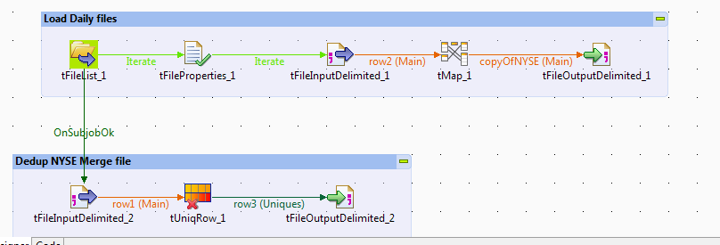
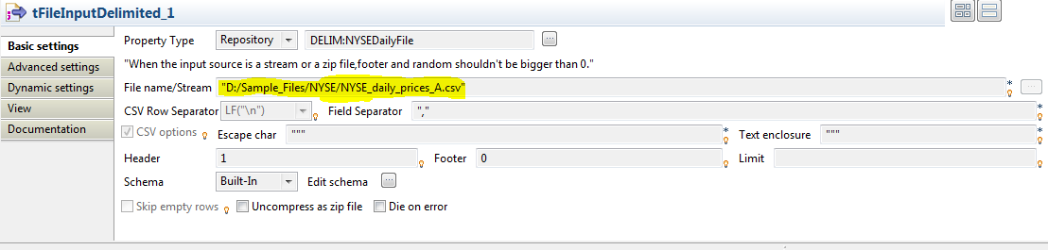
…
Provide Sub Job title for every sub job to describe the sub job purpose/objective
Avoid Hard Coding in Talend Job component. Instead use Talend context variables

Slide 69
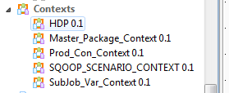
…
Create Context Groups in Repository
Context Group will allow you to use the same context variables in any number of jobs without having to create again and assign value again to them.
Imagine your Project requires 20 context variables and there are 10 jobs that require those context variables. Without context groups it will be very difficult to create those context variables again and again in every job.

Slide 70
…
Create Variables in tMap and use the variables to assign the values to target fields
For multiple use of single expression or for using the same mapping for multiple target fields, it is always good to create a variable in tMap and assign the value of that variable in target fields. It will allow to only evaluating the expression once for multiple number of times.
Create user routines/functions for common transformation and validation
Always create routines/functions for all common transformations and validation rules which can be used in multiple Talend jobs.

Slide 71
Understanding Joblets
A Joblet is a specific component that replaces Job component groups. It factorizes recurrent processing or complex transformation steps to ease the reading of a complex Job.
Joblets can be reused in different Jobs or several times in the same Job.
You can edit a Joblet just like any other Job in the Integration perspective of Talend Studio.
A Joblet is easily identified as it is enclosed in a dotted square on a green background.

Slide 72
How to create a Joblet
In Talend Studio Repository tree view, click the Joblet Designs node to expand the Joblets tree.
Right-click the Joblet Designs node, and select Create Joblet on the contextual menu.
In the [New Joblet] dialog box, fill in at least the Name field to designate the Joblet. You can also add information to ease the Joblet management, such as: Description, Version, Author and Status.
Click Finish to validate your changes and close the dialog box.

Slide 73
…
The design workspace opens showing the Joblet name as tab label. By default the newly created Joblet includes an input and an output Joblet component.
The INPUT component is only to be used if there is a flow coming from the main Job that should be used in the joblet, and the OUTPUT component is only to be used if there is a flow going out of the joblet that needs be used in the main Job. You can remove either or both of them as needed.

Slide 74
…
Include the transformation components you need and connect them to the Joblet input and the output components. If you need lookup connections, include them here as well.
Define the input component schema of the Joblet. As for any component requiring a schema definition, you can define your schema as Built-in, import it from an XML file or retrieve it from the Repository tree view.

Slide 75
Difference – Joblet & tRunJob
Joblet | tRunJob
A Joblet is just a GUI extraction and refactoring of some components. It creates a reusable transformation, the generated code of Joblet is still a part of the Java class of the main Job. | The tRunJob component executes a child Job, which is a separate Java class. The main Job instantiates the child Job and execute it using the runJob method.
a Joblet can access the context variables of the main Job, as it is a part of the main Job. | The tRunJob component is a different unit of execution and has its own context variables. The child Job, called with the tRunJob in the main Job, can't access the context variables of the main Job.
The Joblet code is automatically included in the main Job code at runtime, thus using less resources and improving performance. | tRunJob component can be used as a standalone Job and helps clarifying a complex Job by avoiding having too many sub-jobs in one Job. You can create different Jobs for processing different business requirements, and then create a main Job to run the child Jobs called with the component

Slide 76
Business Models
The Integration perspective of Talend Studio offers the best tool to formalize business descriptions into building blocks and their relationships.
Talend Studio allows to design systems, connections, processes and requirements using standardized workflow notation through an intuitive graphical library of shapes and links.
Talend’s Business Models allow data integration project stakeholders to graphically represent their needs regardless of the technical implementation requirements.
Business Models help the IT operation staff understand these expressed needs and translate them into technical processes (Jobs).
They typically include both the systems and processes already operating in the enterprise, as well as the ones that will be needed in the future.

Slide 77
…
A Business Model is a non technical view of a business workflow need.
In the design workspace of the Integration perspective of Talend Studio, you can use multiple tools in order to:
• draw your business needs,
• create and assign numerous repository items to your model objects,
• define the business model properties of your model objects.

Slide 78
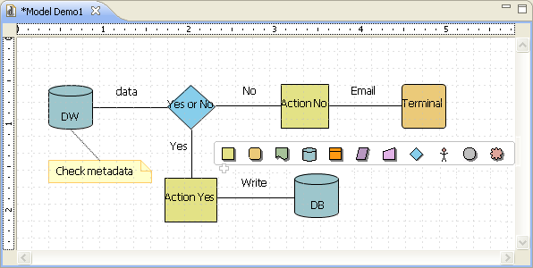
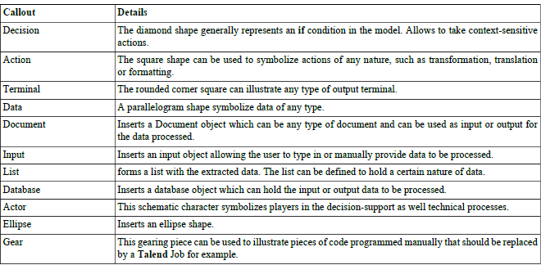
…

Slide 79
Assignment-1
Under ..\CITI\Assignments\Day2\Assignment1 folder, following file is available
Para.txt
Design Talend job(s) to implement following
Word Count
Count by character.
e.g. we need to calculate total words starting with character “A”, “B”,”C”,etc.

Slide 80
Assignment-2
Under ..\CITI\Assignments\Day2\Assignment2 folder, there are following files
NYSE_daily_prices_X.csv
NYSE_dividends_X.csv
Design Talend job(s) to
Iterate through the NYSE folder
Direct daily_prices and dividends files to separate subjobs
Daily_prices subjob should load files to NYSE_Daily_Prices_Staging table in MySQL database. Following transformations should be carried out
Trim all columns
Date conversion – mm/dd/yyyy
Numeric conversion (default should be 0/0.0)
Include filename as additional column in MySQL table
…

Slide 81
…
4) Dividends subjob should load files to NYSE_Dividends_Staging table in MySQL database. Following transformations should be carried out
Trim all columns
Date conversion – mm/dd/yyyy
Numeric conversion (default should be 0/0.0)
Include filename as additional column in MySQL table
5) Design Talend job(s) to calculate following
Avg monthly open, close & high price for each stock
Total dividend paid by each stock in a year
The job should execute in different environments – DEV, QA & PROD. Source file location and target database would change in each environment

Slide 82
Assignment-3
Under ..\CITI\Assignments\Day2\Assignment3 folder, there are following files received from Amazon
AMZ_AMZ0001_PurchaseOrder_99999999.zip
AMZ_AMZ0001_Invoice_99999999.zip
AMZ_AMZ0001_Vendor_99999999.zip
Design Talend job(s) to automate following manual process
Iterate through the source folder and unzip files
Load PurchaseOrder, Invoice & Vendor file to MySQL staging tables
Following basic transformations should be applied on all files
Trim all columns
Date conversion – mm/dd/yyyy
Numeric conversion (default should be 0/0.0)
Include filename as additional column in MySQL table
…

Slide 83
…
Merge incoming files
Remove duplicates based on all columns from all files
Sorting order
PurchaseOrder – ApproveDate (Desc)
Invoice – Date(Asc)
Vendor- Name(Desc)
Output tables should have suffix “*_ND”
Output tables should be exported to “^” delimited files

Slide 84
Day 3 Agenda
Web Services
How to use SVN with Talend Integration Studio
Monitor Job Activity
Running Job remotely
Using Parallel Execution

Slide 85
Quick Re-cap of yesterday
How to use context variables
Log & Error Handling
Managing Routines
Design Joblets and Business Model

Slide 86
Talend Administration Center

Slide 87
Introduction to TAC
The Talend solutions offer the opportunity to work cooperatively on various projects: Data Integration, ESB, Data Management, Data Services, Enterprise Integration, MDM, or all of them.
This collaborative work is handled via Talend Administration Center, a web-based application centralizing the management and administration of your studio. Talend Administration Center also centralizes the users' role management and access rights to your projects and the scheduling and monitoring of processes(Jobs).
Projects and processes are all centralized in a remote repository enabling resource sharing and project configuration.

Slide 88
TAC allows you to:
Manage operating and connection information via the Configuration page of the application
Administrate projects, manage users and licenses via the Projects, Users and Licenses pages.
Schedule deployment and roll-out of processes (Jobs) via the Conductor node and monitor them via the Monitoring node.

Slide 89
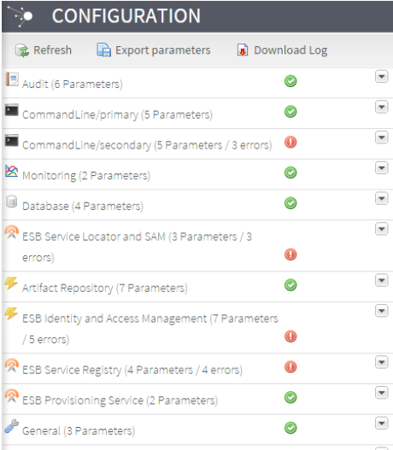
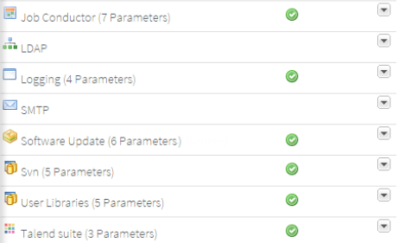
Accessing Configuration Page
From Talend Administration Center home page, you can access the Configuration page that offers accurate details
on application parameters and their related values including database connection. The items displayed in this pagedepend on your license

Slide 90
Managing users, projects and licenses
To access the list of user accounts, click Users in the Menu tree view. This list displays all accounts whether they are Administrators, Operation managers, Designers or Viewers.

Slide 91
Managing rights associated with roles
In the Menu tree-view, click Rights management. The list of roles is displayed in the Role panel on the left and the list of associated rights is displayed in the right panel.
In the Rights management page, the users' rights show next to the roles. The rights displayed depend on the role which is defined in the Users page. For more information, see the section User roles/rights in the Administration Center.
1. In the Role panel, select the role for which you
want to change the rights.
2. In the panel on the right, rights are listed in the
Description column, and are selected by default
in the allowed column.
To restrict the rights associated with this
role, clear the corresponding check boxes.

Slide 92
…
To access the project list stored in the remote repository,
click Projects in the Menu tree view. When you access the
Projects page for the first time, no projects show on the list.
To allocate resources and define user accesses to projects,
you first need to add projects to the list.

Slide 93
Managing licenses
From the license page in Talend Administration Center, an administrator can:
• check the parameters of the licenses and add new licenses.
• validate the license. For more information, see the section Generating a validation request.

Slide 94
Managing project references
A project reference is a property that you can set for a project in Talend Administration Center so that all or some of the project items can be referenced by another project
When one project references another, the items (Jobs, Metadata, Business Modeler and so on) in the referenced project are available for reuse.

Slide 95
…
The main page is divided into two parts:
the Project Reference panel lists projects you have defined as reference on the Project page.
the Project panel shows the references established between projects.
Column | Description
Reference | The * icon shows when the corresponding project has been defined as reference.
Label | The name of the project created in Talend Studio
Branch | The name of the trunk and the branches established for each reference project.
Reference | Different icons show you whether you can set references between the selected projects: White: you can set a reference between the selected projects. Green: a reference already exists between the selected projects. Red: you cannot set a reference between the selected projects.

Slide 96
How to manage SVN branches
In the Menu tree view, click Projects to
display the Projects page.
Select the project for which you want
to create one or more branches.
On the toolbar, click the Branch management
button.
From the Source field, select the trunk or the
branch from which you want to copy the data.
In the Target field, type in the name of the
branch you want to create.
Click create.

Slide 97
Delete SVN branch
In the Menu tree view, click Projects to display
the Projects page.
From the project list, select the project for which
you want to delete an existing tag.
In the SVN tree of project '<ProjectName>', right-
click the tag you want to delete and select
Delete this tag from the contextual menu.
Click OK to confirm the deletion operation and
close the message.
The selected tag is deleted from the SVN tree
of project '<ProjectName>' and from the project
on SVN.

Slide 98
Managing Notifications
The Notifications page allows you to configure alerts based on events. An event can be
a user creation or deletion
a task failure
a change in the status of one or more job servers
If one of the SMTP parameters of the Configuration page is down, a warning will display at the top of the Notifications page to inform you that the notification might not work due to an SMTP server connection error.

Slide 99
Add Task Notifications
On the Notifications page, click Add on the toolbar to create a new
notification.
On the Notification panel to the right, set the following information
Click [Mails Selection] dialog box.
Select the check box(es) next to the user(s) to be added to the notification
Recipients list.
Click Apply to close the dialog box and return to the Notifications page.
If you click the Select All button, an email is sent when any of the tasks fail.
If you click the button, the [Tasks Selection] dialog box pops up.

Slide 100
Add User Notifications
On the Notification panel to the right, set the following information
Select On creation mailTo itself to notify the user that its Talend
Administration Center account has been created.
Select On user creation to send an email notifying the user who
subscribes to this notification type when a new account is created.
Select On user deletion to send an email notifying the user who subscribes to this notification type when a user account is deleted
Click [Mails Selection] dialog box.
Select the check box(es) next to the user(s) to be added to the notification
Recipients list.
Click Apply to close the dialog box and return to the Notifications page.
If you click the Select All button, an email is sent when any of the tasks fail.
If you click the button, the [Tasks Selection] dialog box pops up.

Slide 101
Add Server Notifications
Select On change of server status from the drop-down list to send
an email alert each time the server is down or back to up and running.
Click [Mails Selection] dialog box.
Select the check box(es) next to the user(s) to be added to the notification
Recipients list.
Click Apply to close the dialog box and return to the Notifications page.
Click [Job server selection] dialog box
On the list, select the check box(es) corresponding to the servers to be
monitored.
The selected servers display in the JobServers list in the Notification panel.
On the Notifications page, click Save to validate the changes or click Cancel to ignore them.

Slide 102
Configuring execution servers
Before you can launch any of the execution tasks you have scheduled, you need to configure the servers on which you will deploy them. Ensure that the script is running on the execution server to be able to deploy the task.

Slide 103
Accessing the list of execution servers
In the Menu tree view of Talend Administration Center’s home page, expand Conductor
Click Servers to display the list of the remote execution servers available for deploying and executing tasks
There are three types of execution servers, depending on what you want to deploy and execute:
Job servers (default) This type of server is used to deploy and execute Jobs tasks only when you subscribed to one of our data-oriented products.
Talend Runtime This type of server can be used to deploy and execute Jobs tasks if these Jobs are linked with Services or Routes, but it is especially used to deploy and execute Services, Routes, or even generic OSGi features when you are using our service-oriented products.
the servers on Amazon EC2. This type of server is in fact a JobServer hosted on Amazon EC

Slide 104
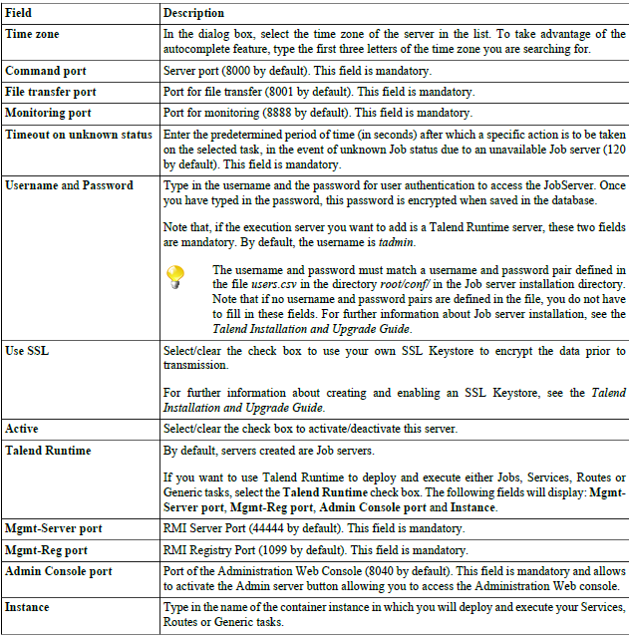
Adding an execution server
From the toolbar on the Servers page, click Add server to open the Execution
server configuration panel.

Slide 105
Adding an virtual server
A virtual server is a group of physical servers from which the best rated server will automatically get preferred at Job execution time.
In Talend Administration Center, simply select physical servers and group them into a virtual server.
Then set the execution task onto this virtual server as for any execution server, in order to automatically select the best server to execute the task onto.

Slide 106
…
The Virtual servers page is divided into two views:
• The Servers view on the left which regroups the physical servers you have configured in the Servers page.
These execution servers can be both JobServers or Talend Runtime servers.
• The Virtual servers on the right which regroups the virtual servers and their assignments.
Adding a virtual server
From the toolbar on the Virtual servers view of the Virtual servers
page, click Add a virtual server to
open the [Virtual server] dialog box
Enter the required information
Click Save to validate the configuration

Slide 107
…
Assigning one or several physical server(s) to a virtual server
On the Virtual servers page, select one or more server(s) in the Job servers view.
Drag and drop the selected server(s) onto a virtual server where you want to regroup or add the server(s)
Deleting an assignment
On the Virtual servers page, right-click on the assigned server entry you want to remove from a virtual server on the Virtual servers view. A pop-up menu appears.
Click Remove assignment. A confirmation message appears to confirm deletion.

Slide 108
Working with Job execution tasks
A Job execution task represents a set of actions that you can configure in Talend Administration Center in order to execute the Jobs designed in Talend Studio directly from the Administration Center. You can also define different types of triggers to launch an execution task.
In the Menu tree view, click Job Conductor to display the list of scheduled tasks that will deploy and execute Jobs on a remote server.

Slide 109
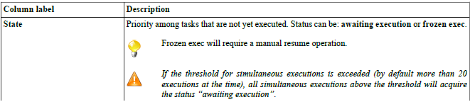
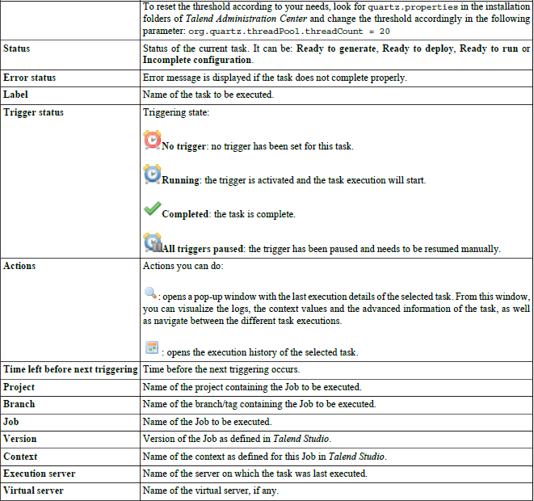
…

Slide 110
Adding an execution task
The Talend Administration Center allows you to add execution tasks on Jobs that are either based on the SVN repository, or pre-generated by the Studio as zip files. According to your needs, read one of the procedures below.
Adding an execution task on a Job based on SVN repository
From the toolbar on the Job Conductor page, click Add task
to clear the Execution task configuration panel.

Slide 111
Scheduling execution tasks
You can schedule your tasks based on time or event, using time triggers or file triggers respectively.
Time-based scheduling can be linked to a simple trigger or to a CRONUI trigger depending on the way you want your time-based triggered task to be executed, either at a defined time and date or regularly over a period of time.
You can also schedule your task to be executed based on a file trigger. The presence of a file in a defined location will trigger the job execution task
Time-based triggers (SimpleTrigger):
Periodic multi-platform CRON-like triggers (CronUITrigger):
File-based triggers (FileTrigger):

Slide 112
Adding Triggers
To schedule the execution of your tasks, you can set time-based triggers (simple or CRON) or event-based triggers (file) onto a task that will start its execution.
If you want to schedule one or several execution of a task at a precise moment, you can use the simple trigger.
If you want to schedule one execution of a task on a regular basis (daily, weekly, monthly etc.), you can use the CRON-based trigger.
If you want to execute a task on a file-based event, such as the presence, creation, modification of the file, you can use the File trigger.

Slide 113
How to add a simple trigger
You can add a simple trigger onto a task to schedule
one or several execution(s) at a defined date and
time.
On the Job Conductor page, select the task you want
to implement a trigger on. In the bottom half of the
page and in the Triggers view, click Add trigger...
and then select Add simple trigger from the
drop-down list.
The Simple trigger configuration panel opens.
Enter the required information:

Slide 114
How to add CRON-based trigger
If you need to execute a task on a regular basis over
a period of time, then use a CRON-based trigger.
On the Job Conductor page, select the task you
want to implement a trigger on.
In the Triggers view, click Add trigger... and then
select Add CRON trigger from the drop-down list.
The CRON trigger configuration panel opens.
Fill in the Label and Description fields and then click
Open UI configurer to open the Cron UI trigger
configuration dialog box.

Slide 115
…
Select the hour and date items at which
you want the task to be executed as the
Following →
Click Apply modifications. The dialog box
closes and the selected data is displayed in
the CRON UI trigger configuration panel.
Click Save to validate the CRON-based
trigger configuration or Cancel to cancel the
operation.
The Trigger Status for the selected task
changes from No Trigger to At least one trigger is running.

Slide 116
How to add a File trigger
You can use a file to trigger the job execution task. The
presence of this file in a defined location will trigger the job
execution task. This file becomes then a job trigger with no other
purpose.
The file trigger principle is as follows:
Talend Administration Center polls the JobServer according to the
Interval specified in the File trigger definition. When a file
corresponding to the defined File mask and File situation is
detected in the polling folder, an event is created and added to the
event queue of the JobServer.
If several files correspond to the filemask, then an event is added
to the queue.
This event queue is then transferred to Talend Administration Center which then triggers the job task and possibly
sends the job-defined context parameters to the execution server.

Slide 117
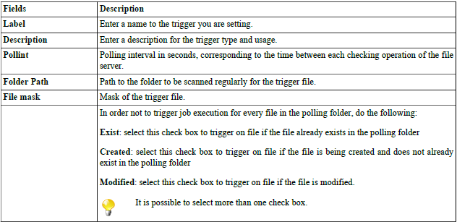
…
On the Job Conductor page, select the task you want to implement a trigger on.
In the Triggers view, click Add trigger... and then select Add file trigger from the drop-down list. The File trigger configuration panel opens.
Enter following information
Click Save to validate the File trigger configuration or Cancel to cancel the operation.

Slide 118
Monitoring task execution and accessing logs
Talend Administration Center gives access to the Monitoring node which provides detailed monitoring capabilities that can be used to:
consolidate log information collected,
understand the underlying component and job interaction,
provide task execution information in a timely manner,
prevent faults that could be unexpectedly generated,
support the system management decisions.

Slide 119
Migrating your projects
If you migrated to a newer version of Talend Administration Center and want to retrieve your existing projects, you may want to migrate these projects. Talend Administration Center allows you to select the projects to be migrated and to generate corresponding reports using the Commandline applications.
The Migration Check page of Talend Administration Center allows you to:
connect the previous version of your CommandLine application to the new one
migrate each existing project
generate and download a report for each migration
Note that you can also migrate projects and generate reports directly from the CommandLine thanks to the migrationCheck and generateMigrationReport command.

Slide 120
Migrating your projects
If you migrated to a newer version of Talend Administration Center and want to retrieve your existing projects, you may want to migrate these projects. Talend Administration Center allows you to select the projects to be migrated and to generate corresponding reports using the Commandline applications.
The Migration Check page of Talend Administration Center allows you to:
connect the previous version of your CommandLine application to the new one
migrate each existing project
generate and download a report for each migration
Note that you can also migrate projects and generate reports directly from the CommandLine thanks to the migrationCheck and generateMigrationReport command.

Slide 121
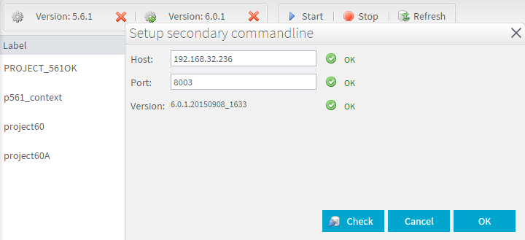
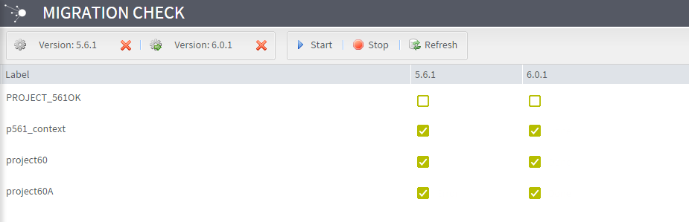
Migrating your projects
To migrate your projects, proceed as follows:
In the Menu tree view of Talend Administration Center, click Migration Check to open the corresponding page.
Click the CommandLine buttons on the top toolbar to configure the connections to both source (old) and target (new) CommandLine applications

Slide 122
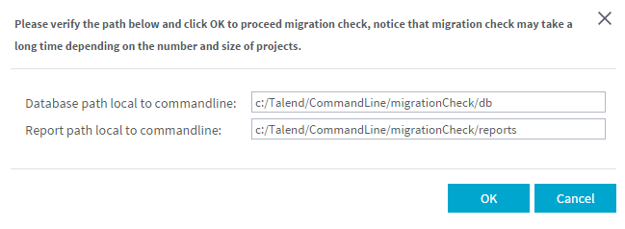
Migrating your projects
Click Start on the top toolbar to start the migration of your projects.
In the pop-up window that opens, enter the paths to the local directories where the database and report will be stored and click OK.
The migration starts and reports are generated. For more information on reports, see Accessing detailed reports on migration.

Slide 123
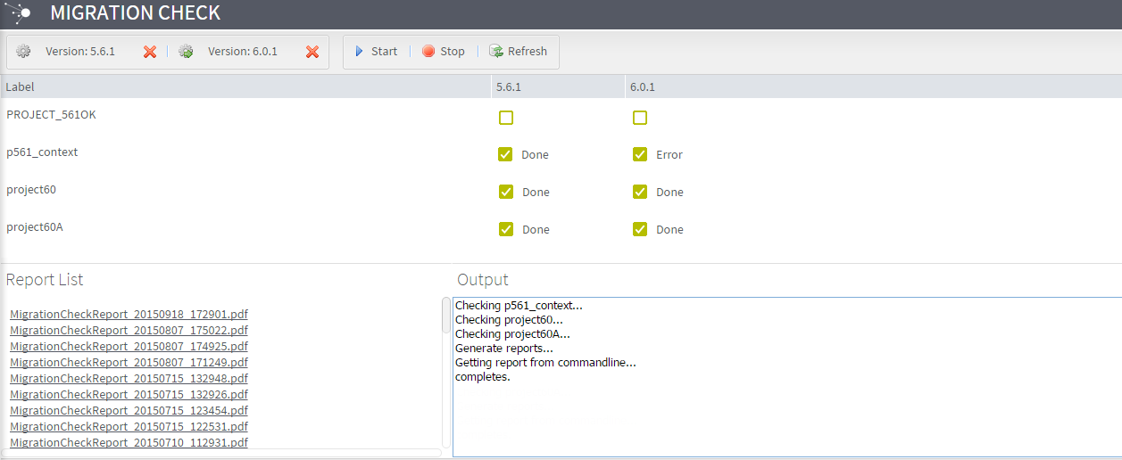
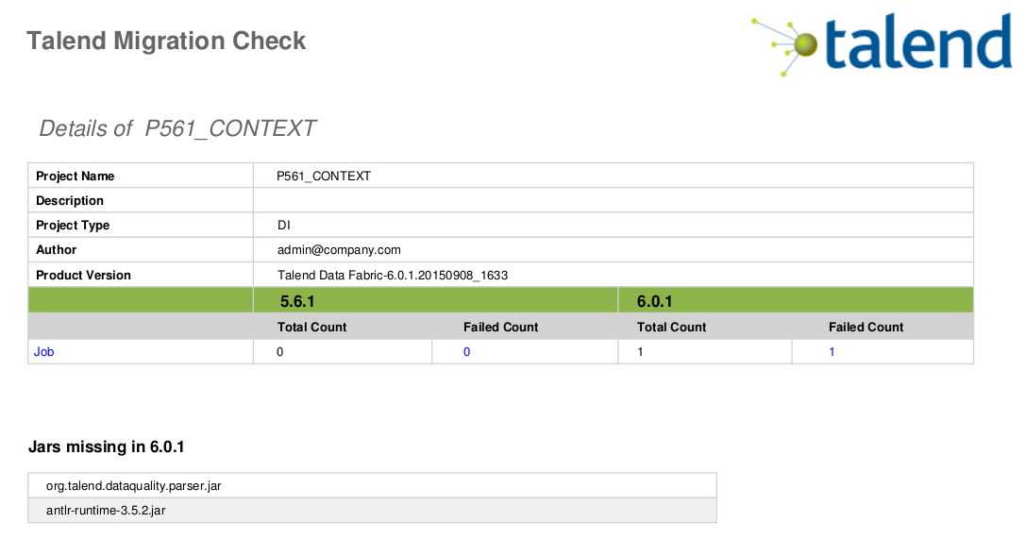
Migrating your projects
To obtain more details regarding a project
migration check, click the name of a project.
The number of items migrated, missing
components or libraries and so on are listed.

Slide 124
Backing up databases and SVN repositories
The Backup page allows you to schedule the backup of your databases (administration center database, Audit database, Talend Activity Monitoring Console database, etc.) and SVN repositories.
On the Backup page, you are able to:
schedule the backup of your databases and/or SVN repositories and define the frequency of backups,
run a backup of your databases and/or SVN repositories manually,
store the backed up databases or SVN repositories in a specified directory.

Slide 125
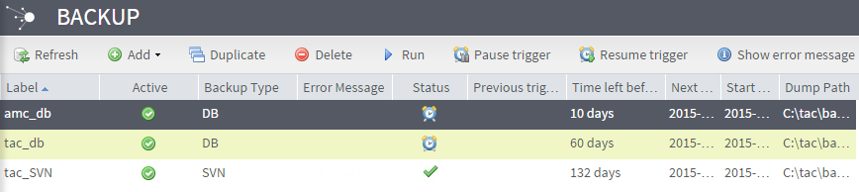
Scheduling a backup
On the Backup page, you can schedule the backup of your databases (administration center database, Audit database, Talend Activity Monitoring Console database, etc.) and SVN repositories.
Scheduling the backup of your database
In the Add list of the top toolbar, select Add DB. A form which allows you to schedule your backup opens.
Fill in the following information:

Slide 126
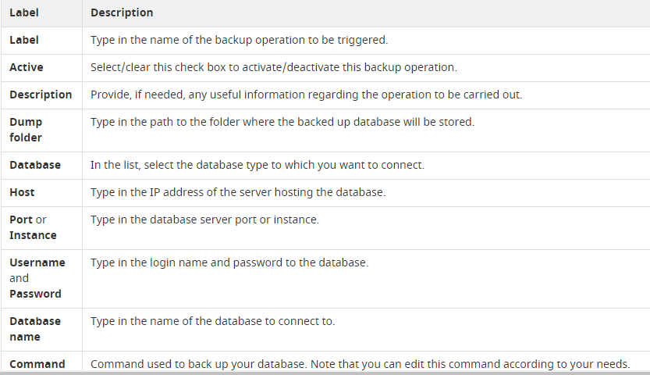
Scheduling a backup

Slide 127
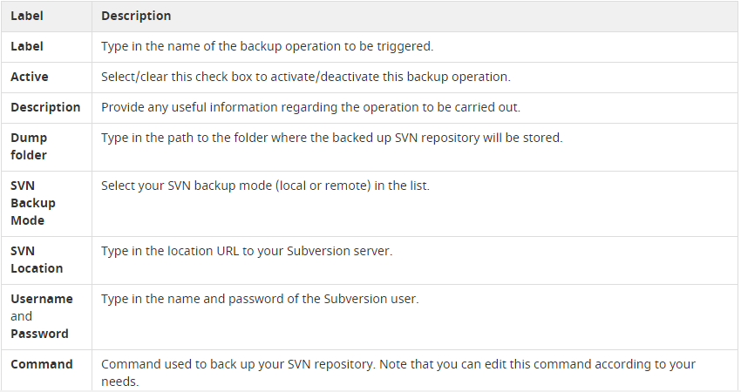
Scheduling a backup
Scheduling the backup of your SVN repository
In the Add list of the top toolbar, select Add SVN. A form which allows you to schedule your backup opens.
Fill in the following information:

Slide 128
Introduction to Big Data platform

Slide 129
Talend Big Data Platform
Talend's Big Data solutions provide a powerful tool set that enables users to access, transform, move and synchronize big data by leveraging the Apache Hadoop Big Data Platform and makes the Hadoop platform ever so easy to use
It enables users to handle big data easily by leveraging Hadoop and its databases or technologies such as HBase, HDFS, Hive and Pig.
Talend's big data solutions provide comprehensive support for all the major big data platforms.
Talend's big data components work with leading big data Hadoop distributions, including Cloudera, Greenplum, Hortonworks and MapR.

Slide 130
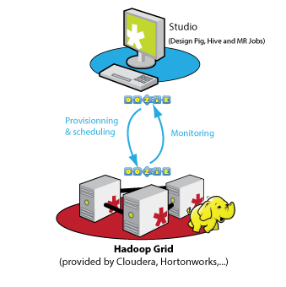
Functional Architecture
Three different types of functional blocks are defined:
at least one Studio where you can design big data Jobs that leverage the Apache Hadoop platform to handle large data sets.
a workflow scheduler system integrated within the studio through which you can deploy, schedule, and execute big data Jobs on a Hadoop grid and monitor the execution status and results of the Jobs.
a Hadoop grid independent of the Talend system to handle large data sets.

Slide 131
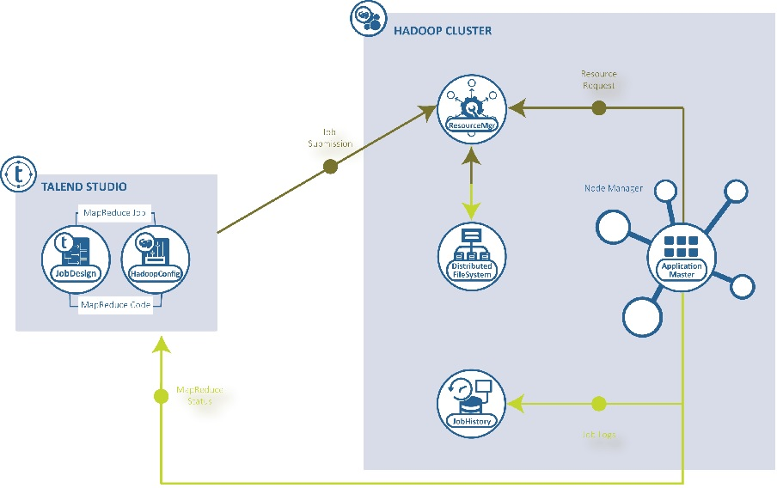
How Talend works with Hadoop…

Slide 132
…
In Talend Studio, you design a MapReduce Job using the dedicated MapReduce components and configure the connection to the Hadoop cluster to be used.
At runtime, this configuration allows the Studio to invoke the client API provided by Hadoop (the API package isorg.apache.hadoop.mapred) and then to submit the MapReduce Job to the ResouceManager service of the Hadoop cluster being used and copy the related Job resources to the distributed file system of the same cluster.
The Hadoop cluster then completes the rest of the execution such as initializing the Job, generating Job ID and sending the execution progress information and the result back to the Studio.

Slide 133
Please Note…
Note that a Talend MapReduce Job is not equivalent to a MapReduce job explained in Apache's documentation about MapReduce.
A Talend MapReduce Job generates one or several MapReduce programs (jobs in Apache's sense), depending on the way you design theTalend Job in the workspace of the Studio.
When you create the Job, the progress bars that appear with the MapReduce components dropped in the workspace indicate how the MapReduce programs are generated and the execution progress of each map or reduce computation.

Slide 134
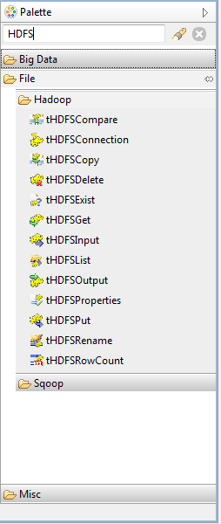
HDFS components
Talend Big data platform offers wide range of components to work with HDFS seamlessly.
Component parameters are similar to other components available.
The components are primarily designed to access HDFS through TIS, they do not have capability to execute MapReduce job on cluster

Slide 135
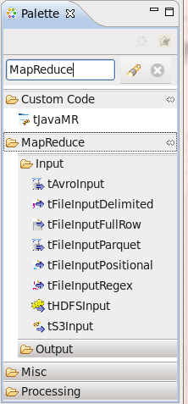
MapReduce components
These components are part of the Map/Reduce components provided by Talend and are grouped in the MapReduce family of the Palette.
This family, as well as the other Map/Reduce components, becomes available only when you are creating a Map/Reduce Job.
Basic transformation like filter, sort, aggregate, Join & tMap are available as a part of MapReduce components

Slide 136
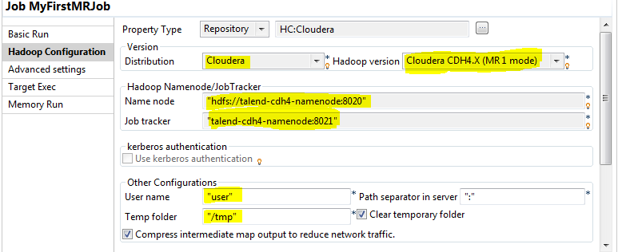
Configure Hadoop connection
Before being able to run a Talend MapReduce Job, you need to configure its connection to Hadoop. To do this, proceed as follows:
From the Repository tree view of the Integration perspective of the Studio, double-click the MapReduce Job you have created and want to run so as to open it on the workspace.
Click the Run tab to open its view and click the Hadoop configuration tab.

Slide 137
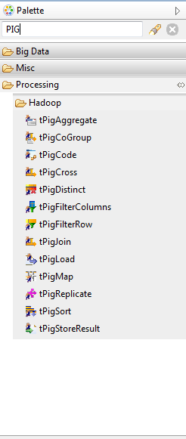
PIG components
Talend Big data platform offers wide range of components to work with PIG seamlessly.
Similar to native PIG, Talend components also offer two execution modes for PIG components –
Local
MapReduce
Unlike HDFS components, PIG components will execute a MapReduce job if said execution mode is selected

Slide 138
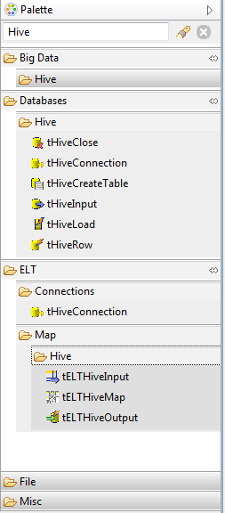
Hive components
Apache Hive is a data warehouse infrastructure build on top of Hive, originall developed by Facebook.
By default, this component uses the HortonWorks distribution of Apache Hadoop. You may select alternative distributions from the drop-dpwn list
You will then need to select the Hive version that you would like to use with this distribution .

Slide 139
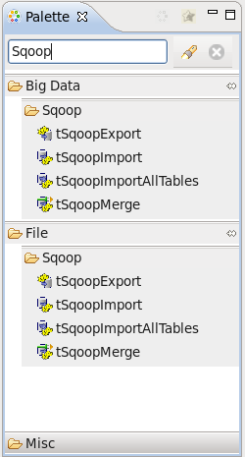
Sqoop components
Apache Hive is a data warehouse infrastructure build on top of Hive, originall developed by Facebook.
By default, this component uses the HortonWorks distribution of Apache Hadoop. You may select alternative distributions from the drop-dpwn list
You will then need to select the Hive version that you would like to use with this distribution .

Slide 140
Talend Data Quality… Overview

Slide 141
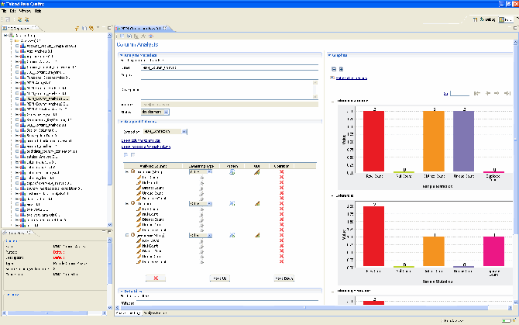

Talend Open Profiler
Industry’s first open source data profiling software
Examine data contained in data sources
Collect information and statistics about the data
Features
Metadata discovery
Statistics
Data validation
Key Benefits
Discover level of quality of data
Understand data characteristics
Identify potential problems before beginning data projects
Reduce time and resources needed to find problematic data
Allow business analyst to have more control of maintenance and data management

Slide 142
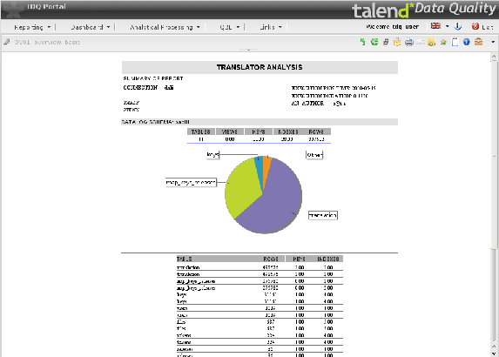
Talend Data Quality…
Subscription service, extends Talend
Data Profiler
Discover and assess quality of data
Trace history of data quality
Data Cleanser
Transform data to improve its quality
Eliminate or recycle erroneous records
Correct bad data
Interface with:
Name, address & Phone validation databases
Synonym tables and lookup data
External data cleansing routines
Filtering / Correction / Enrichment

Slide 143
…
Benefits
Integrated suite for diagnosing and
fixing erroneous data
Data Profiling
Measure and track level of quality
Preserve historical records for measuring
Improvement or degradation
Data Cleanser
Eliminating data inconsistencies, duplicates,
etc.
Produce augmented / enriched data
Standardizes data
Complete data quality lifecycle management
Natively integrated with Data Integration
Implement a “data quality firewall” in data integration process

Slide 144
Data Quality
A Broad topic…
Measure the quality of data
Ensure quality upstream
Cleanse poor quality data
What is data quality? It depends…
Accurate data
Correct amount for orders, correct birth dates for employees
Complete data
Phone numbers, descriptions filled out; right data in the right field
Consistent data
Product reference in order matches a product, sum of sales per sales rep matches total sales number

Slide 145
Why Data cleansing…
“Garbage in, garbage out”
Erroneous analysis data => Erroneous analysis
Inability to make decisions
Poor decision making
Importance of cleansing increases with the increase of integration
Like a virus, poor data quality propagates from application to application
Quick contagion to the entire information system

Slide 146
What is new in Talend 6???

Slide 147
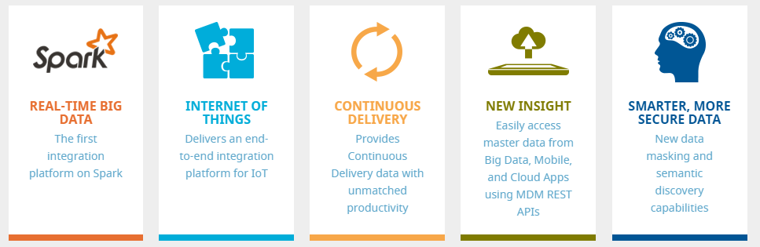
Why Data cleansing…
Data-driven companies are constantly challenged to process more data at a faster pace. Using day or week-old data to make business decisions is no longer an option. Customers and shareholders expect you to operate in real-time.
Talend 6 introduces pioneering innovations unleashing the power of Apache Spark for real-time big data integration. We are proud to announce the following new capabilities providing you unprecedented power to get the most from all your data:

Slide 148
The first data integration platform on Spark
Visually develop jobs that run 100% on Spark with a 10X developer productivity gain over hand-coding
Spark simplified using 100 drag-and-drop Spark components for Hadoop/HDFS, Cloud SaaS and Storage, Messaging Services, IoT, Databases and NoSQL, Transformations and Machine Learning.
Provides in-memory analytics and machine learning components speeding decisions and allowing you to analyze streaming data in-memory over a defined window of time
Easily convert Talend MapReduce jobs to Spark with the click of a button, future proofing your integration investments

Slide 149
Platform for the Internet of Things
Talend provides the first end-to-end integration platform to reliably capture and deliver millions of events per second then instantly ingest, process and deliver insight to real-time applications and fast NoSQL data stores.
Reliably captures and delivers millions of events per second
Seamless integration with Apache Kafka, Amazon Kinesis, Apache Flume
Support for AMQP, MQTT through Talend ESB
High-scale ingestion, machine learning and real-time analytics through Spark
Integrate Hadoop or NoSQL, on-premises on in the cloud

Slide 150
Built-in Lambda Architecture
Talend 6 provides a comprehensive built-in Lambda Architecture giving you incredible agility to build intelligent data applications that seize opportunities and stop threats as they occur. A Lambda Architecture balances latency and throughput by combining comprehensive batch data (batch layer) with real-time stream processing (speed layer) into data sources for querying (serving layer).
A single solution to address bulk/batch, real-time, streaming and IoT data
Provides Fast Data access through NoSQL
One tool for Hadoop, Spark, traditional ETL/ELT and NoSQL integration

Slide 151
Makes data smarter and more secure
Better understand your raw data, enrich their formats so that they can be easily connected and shared, and protect your most sensitive data through data masking.
New data masking components obfuscates and secures personal data as it is shared throughout the enterprise, protecting against abuse or breaches while addressing compliance and privacy mandates.
HDFS file profiling streamlines the process of turning unstructured big data into structured data.
Interactive profiling allows data preview with auto-sampling to discover the content and apply the best profiling patterns.
Cloudera Navigator can trace data lineage for MapReduce.
New email validation component with advanced syntax checking, together with address validation in the cloud, turn contact data into trusted sources of customer information.

Slide 152

Extends your integration reach
Talend continues to add and update its extensive list of over 900 enterprise application components and connectors. Also, Talend now supports Java 8 and Eclipse 4.4 providing access to their latest features.
New and Enhanced Hadoop and NoSQL Platforms
Cassandra 2.1.6 | Neo4J 2.1 | MongoDB 3.0 | Cloudera: 5.4 | Hortonworks: 2.2 | MapR: 4.1 | Pivotal: 2.0.1 | Hadoop 2.4 | Spark 1.3
New and Updated Components
Microsoft CRM 2013, 2015 | AWS DynamoDB | MarketoOracle 12 | MySQL 5.6 | MariaDB 10 | DB2 v10.5 | Microsoft SQL 2014 | Postgres 9.4 | Teradata 15 | Vertica 7.1 | Netezza 7.x | Cassandra (support of CQL 3)

